Slide 1
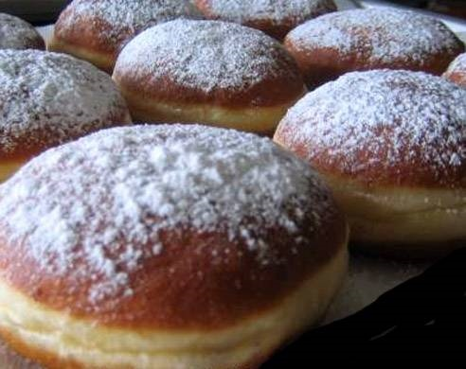
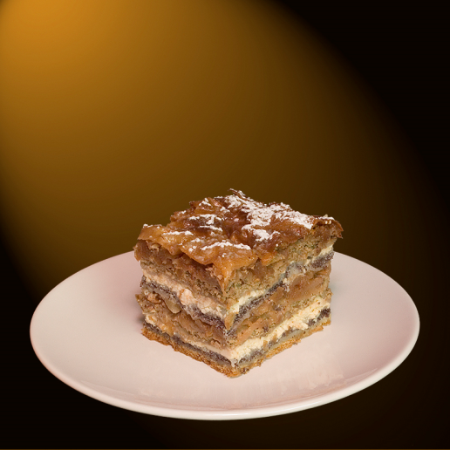
MEALS IN SLOVENIA

Slide 2
Shopping
We buy food at the supermarkets or markets. We have a lot of supermarkets: Tuš, Spar, Mercator,…

Slide 3
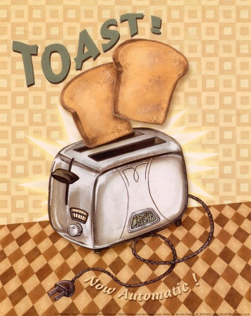
BREAKFAST
In my country we usually eat breakfast at 8 or 9 o’clock. We eat toast with butter and marmelade,eggs, cereal, chocolate flakes. We drink tea,coffe, milk, juice.

Slide 4
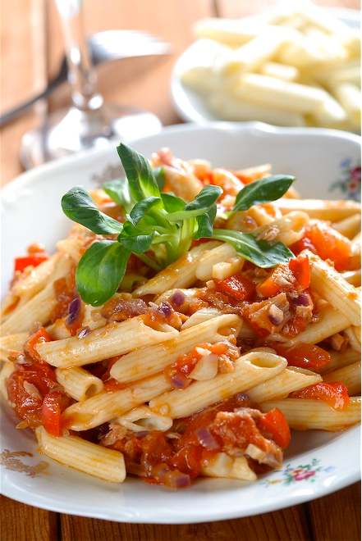
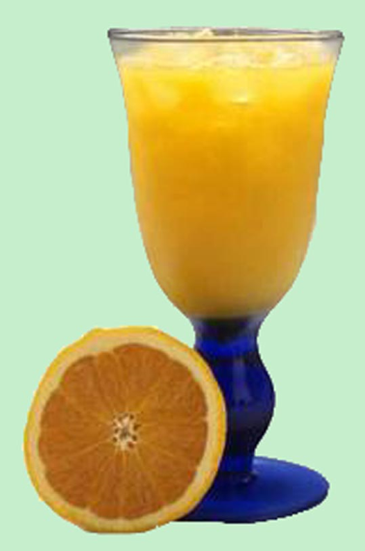
LUNCH
We eat lunch at 12 or 1 o’clock. We eat chicken, potatoes, salad and soup or sometimes we eat pasta with tuna. We drink juice or sometimes water with our meal.

Slide 5
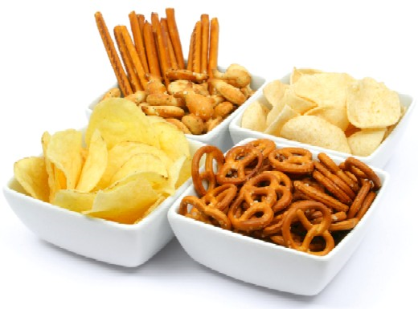
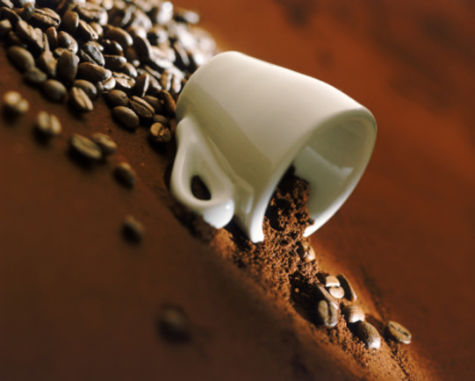
SNACKS
For snacks we eat sandwiches, sweets, cookies, chrisps or a pizza.
We drink cola or tea. Adults sometimes drink coffe with cookies.

Slide 6
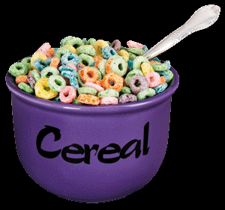
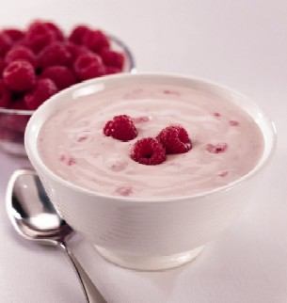
DINNER
We have dinner at 6 or 8 o’clock. We eat yoghurt or milk and cereal. We sometimes go out to the restaurant and we have a good dinner there.

